Slide 1
Web Services
8 – Architecture
Steven F. Lott

Slide 2
Agenda
Nuclei around which architecture crystallizes
Architecture Design Patterns

Slide 3
Decision Nucleus
Interface-Driven Decisions
  External Interactions are typically web services
Several Implementations
  Heavyweight, SOAP document services
  Lightweight, RPC services
  Informal CGI and other HTTP services

Slide 4
Decision Nucleus
Data Model- or Processing- Driven Decisions
  Complex or Core data
    Can be accessed directly (through JDBC) ☹
    Or indirectly through a web service ☺
  Complex Processing
    Can be accessed through a web service as needed ☺
    Or built as a batch job and run periodically ☹
Business Focus is essential

Slide 5
Decision Nucleus
Mutability-Driven Decisions
  If the implementation will change,
    wrap it in an interface that won't change.
Special cases are often mutable
  So wrap them in a web service
Interim Solutions
  Best to wrap them in a service
  Replace the interim implementation with the final

Slide 6
Poor Choices for Web Services
Individual Data Entity Access
  Entity-Level services are too fine-grained
  Each CRUD operation has to be exposed
  It basically wraps the SQL, adding overhead
    With no measurable value
Technical Processes (ETL, for example)
  Moving "Customer" from system to system isn't what a service does
    No Business Focus – just data massaging
Service Design Questions
  Where's the system of record? Who's the keeper of the master data?
  What do other systems need this system to DO for them?
  The system of record may publish useful services

Slide 7
Data Movement/ETL
Single sources for Master Data?
  Then a single Service for this data
Duplicate sources – overlapping Master Data?
  System X source copied to System Y where extra attributes were added
  Coalesce into a single source, if possible
  Make multiple applications share a single, central service for the data – where possible
Multiple sources – multiple parts to the Master Data?
  System X has some records, System Y has other records
    Union of these two systems is the master data
  Hard to coalesce, but a Single Service can wrap multiple sources for consistency

Slide 8
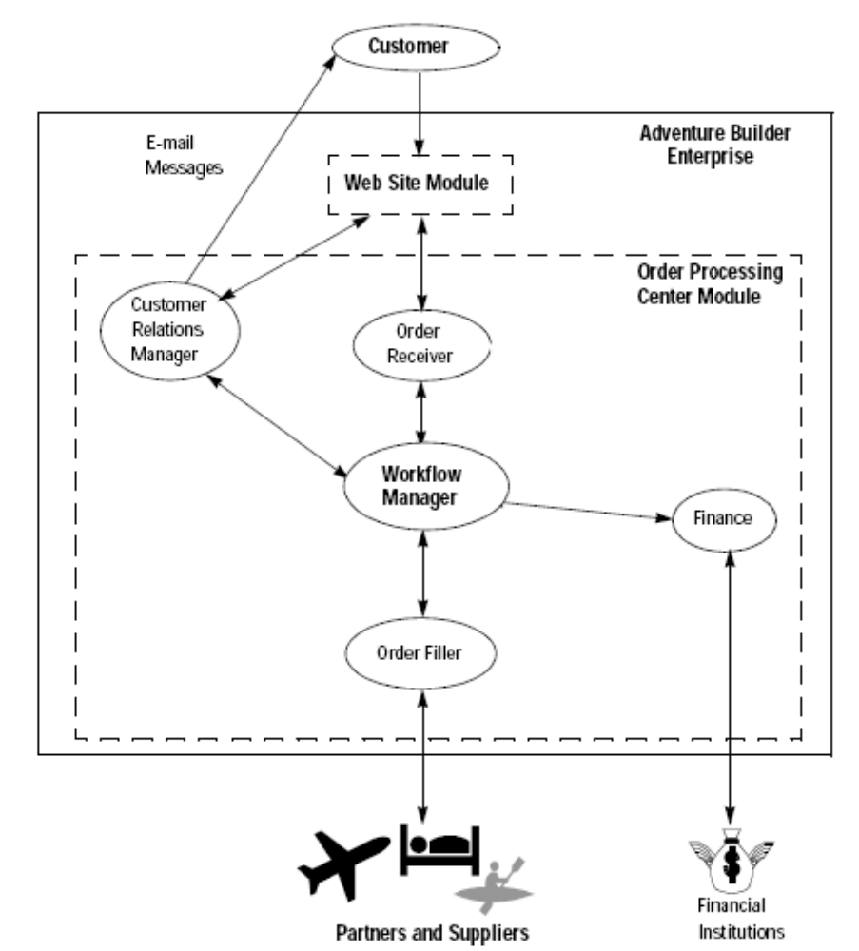
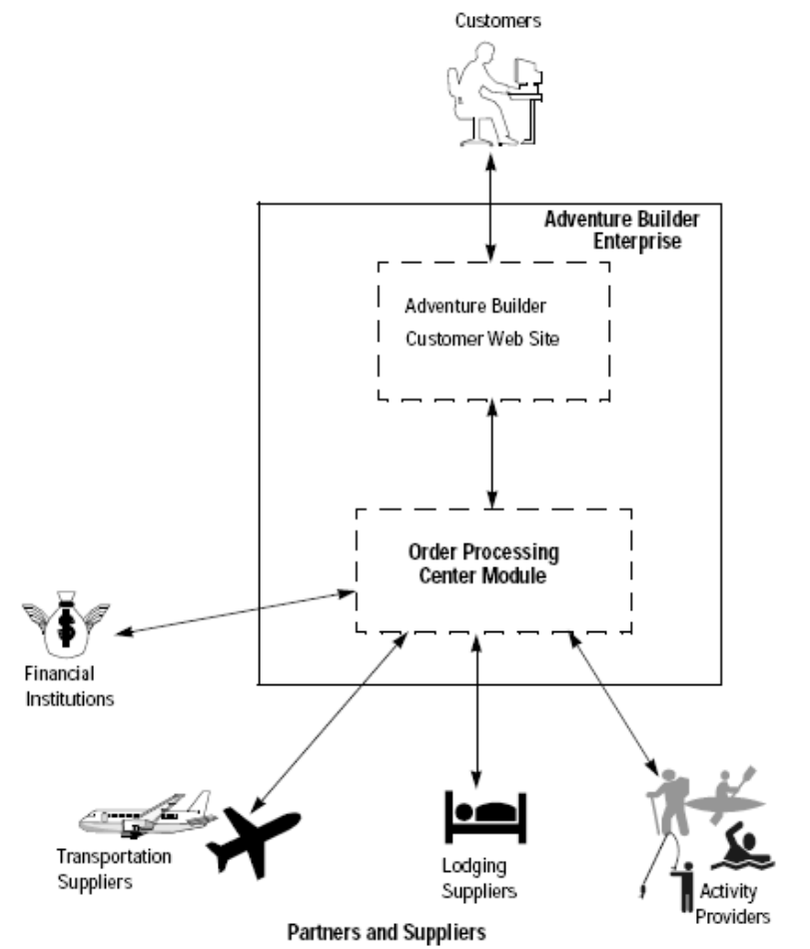
The Java
Blueprints Reference

Slide 9
Adventure Builder
A J2EE application that presents an application to end-users
Consumes Web Services for a number of Back-end Operations
Suppliers and Finance are external interfaces
CRM is a shared data structure
Workflow is Process-driven
Order Receiver is a mixed bag

Slide 10
The Granularity Issue
Services which are too small ("chatty")
  Endless back-and-forth
  Too much SOAP overhead for the real value
Services which are too large
  Giant XML messages
  Long-running web services
In the middle is a balance
  This is more art than science
Business focus is key

Slide 11
Business Focus
It's all about Agility
It's all about Master Data
  One source for the data
  One source for the processing
It's all about Assignment of Responsibility™
Important Questions:
  What is really happening?
  Is that business-related or is that a dumb technology work-around because of rubbish legacy software?
  MUCH of what passes for "business analysis" is really IT reverse engineering

